Slide 1
Ablation Preliminary Experiment Study
06/25/2026
By Ying-Kuan (Rick) Tsai at Northwestern
(Data provided by Yinong Chen at UIC)

Slide 2
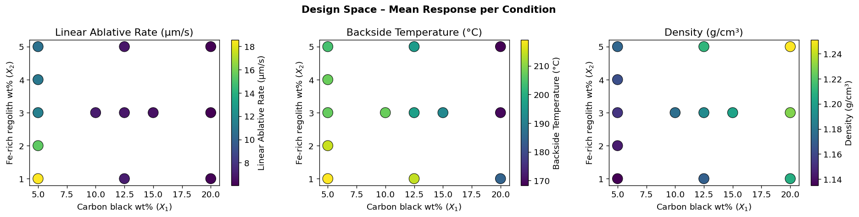
Problem Definition and Data
4 factors but only 2 independent inputs (Carbon black wt%, Fe-rich regolith wt%), I-369 wt% is fixed at 2%, sum should be 100%
3 Outputs (Ablation rate, Backside Temp, Density; lower = better)
13 Conditions with 3 replicates for each (39 total observations)

Slide 3
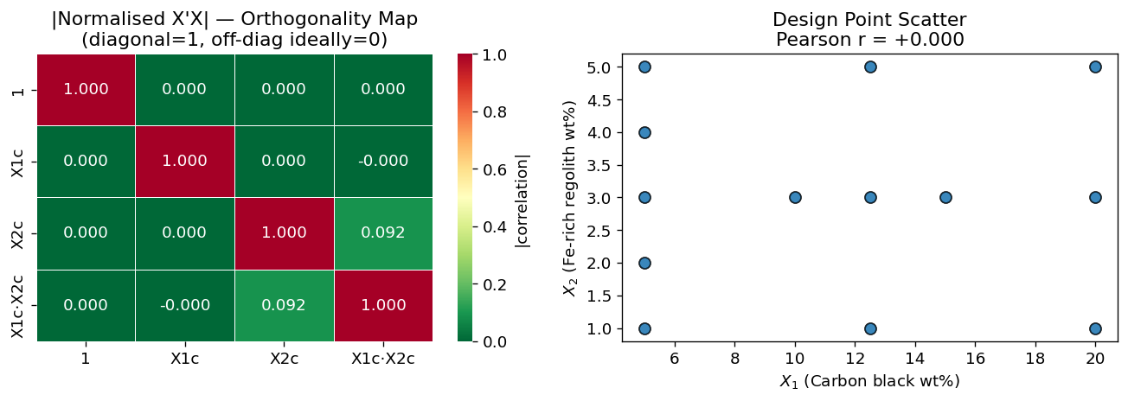
Orthogonality Check
✓
✓
✓
r = 0.00
κ = 77.9
Off-diag ≈ 0
Pearson correlation X₁ vs X₂
(p = 1.00)
Condition number of centred
design matrix X'X
Normalised X'X off-diagonal
elements near zero
Interpretation: Main effects X₁ and X₂ are perfectly uncorrelated (r = 0). The centred design matrix is near-orthogonal (κ = 77.9 < 100). The only mild off-diagonal correlation (0.09) is between the centred X₂ term and the interaction X₁·X₂, which is expected when X₁ is unbalanced across X₂ levels.

Slide 4
Two-Way ANOVA Results
Source | Y₁ Ablation F (p) | Y₂ Temp F (p) | Y₃ Density F (p)
X₁ (Carbon black) | 1247 (p < 0.001) *** | 714 (p < 0.001) *** | 2.6×10³¹ ***
X₂ (Fe-regolith) | 4.86 (p = 0.037) * | 42.8 (p < 0.001) *** | 1.0×10³⁰ ***
X₁ × X₂ interaction | 35.9 (p < 0.001) *** | 10.5 (p < 0.001) *** | 2.7×10²⁹ ***
R² | 0.981 | 0.747 | 1.000
Carbon Black (X₁) is the dominant factor
Fe-rich Regolith (X₂) plays a secondary role
X₁ × X₂ Interaction is strong for Y₁ and Y₂

Slide 5
Quadratic Linear Regression Models
Model: Ŷₖ = β₀ + β₁X₁ + β₂X₂ + β₃X₁² + β₄X₂² + β₅X₁X₂
Term | β₁ Y₁ Ablation | β₂ Y₂ Temp | β₃ Y₃ Density
Intercept (β₀) | 29.919 *** | 224.964 *** | 1.10484 ***
X₁ (β₁) | –2.181 *** | +2.192 | +0.00418 ***
X₂ (β₂) | –3.870 *** | –11.524 | +0.00798 ***
X₁² (β₃) | +0.051 *** | –0.185 ** | +0.000022 ***
X₂² (β₄) | +0.240 * | +1.283 | +0.000174 ***
X₁·X₂ (β₅) | +0.136 *** | –0.021 | +0.000097 ***
R² | 0.922 | 0.740 | 0.9999
RMSE | 1.18 µm/s | 10.07 °C | 0.0003 g/cm³

Slide 6
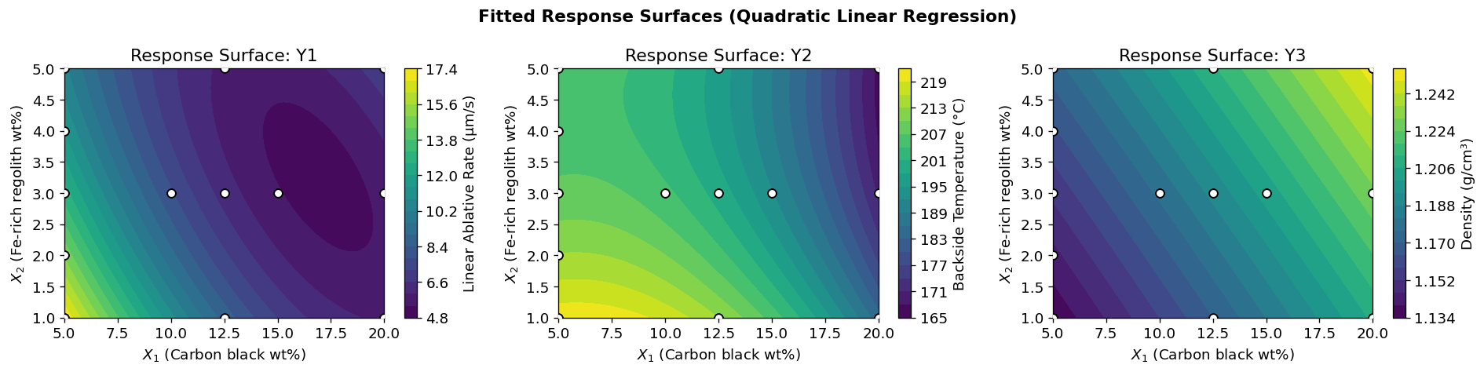
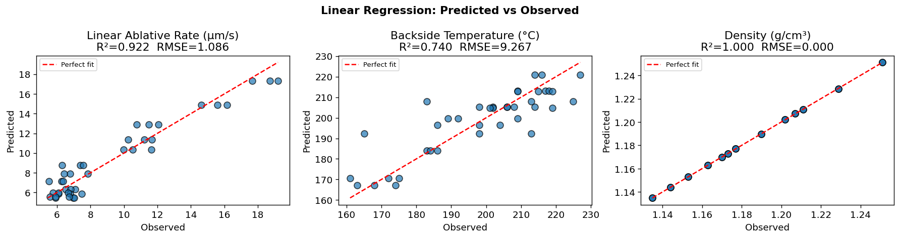
Quadratic Linear Regression Models
Model: Ŷₖ = β₀ + β₁X₁ + β₂X₂ + β₃X₁² + β₄X₂² + β₅X₁X₂

Slide 7
Discussion
Carbon black (X₁) is the primary ablation-control lever. Higher loading increases char density, which mechanically resists ablation and reduces heat penetration. The nonlinear (quadratic) decay in ablation rate suggests saturation beyond ~12.5 wt% — additional carbon offers diminishing returns.
Backside temperature shows the highest experimental variance (R²=0.75). The negative interaction of X₁ and backside temperature suggests that carbon-rich chars act as effective insulators. Fe-rich regolith at higher levels reduces temperature, potentially through a particulate heat-sink mechanism.
With only 39 runs and a space-filling design, the experiment is efficient but not fully factorial. The near-orthogonality (κ=77.9) confirms that factor effects are estimable without confounding. However, the sparse coverage at high X₁ × high X₂ is a limitation for extrapolation in that region.
Density output is seen to follow a very linear relationship in the X₁-X₂ space, which is why the R-square is very close to 1

